Slide 1
ER Mobile: How to Operate ‘Assurant’ tickets from Service Power
Ver. 1.1
By: James Whang

Slide 2
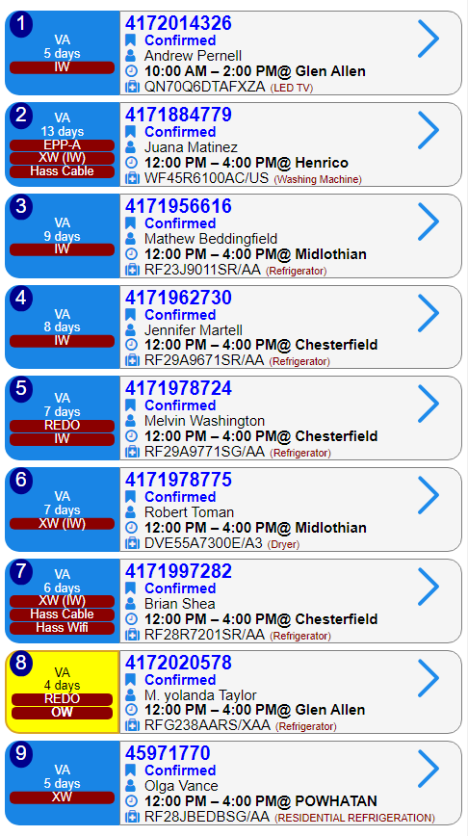
ER Mobile: Introducing Assurant Tickets
We are now getting tickets from Service Power. These tickets are referred to as Assurant tickets.
They have a different ticket number as compared to Samsung’s ‘417-’ ticket number

Slide 3
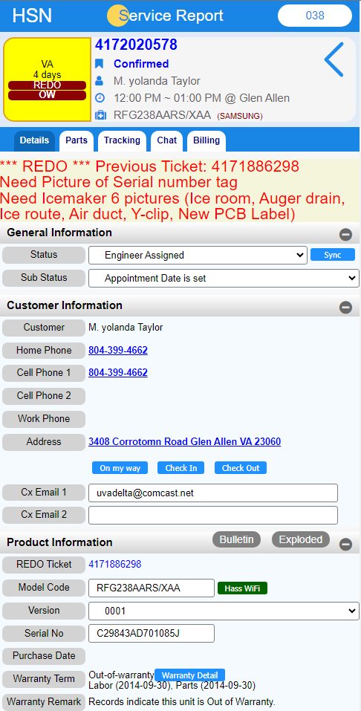
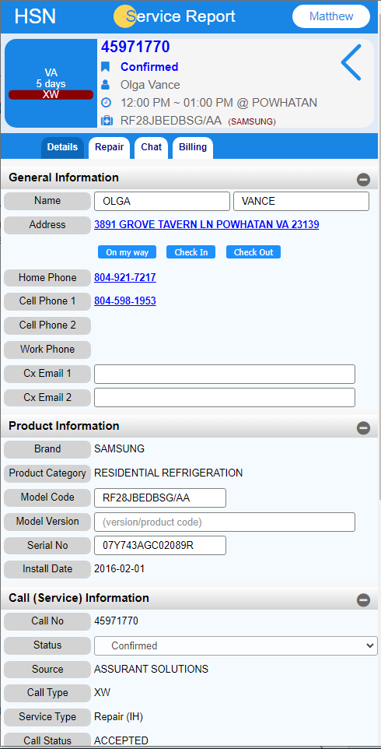
‘Samsung’ Ticket
‘Assurant’ Ticket
Notice the different Layout between the two types of Tickets.

Slide 4
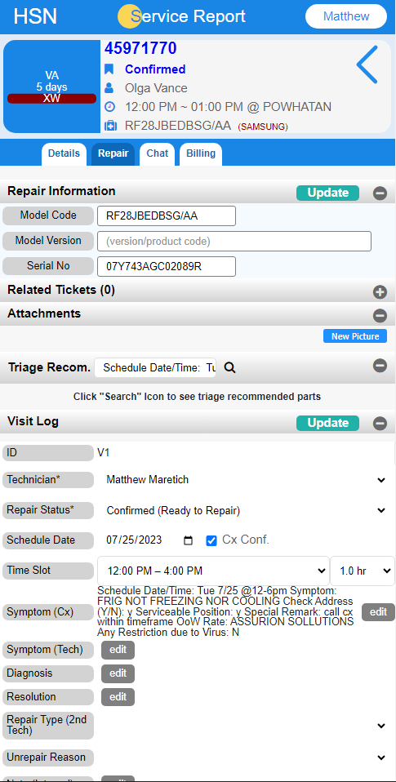
ER Mobile: How to Update tickets as a Technician
1. Navigate to the ‘Repair’ tab
2. Scroll down to ‘Visit Log’
This is where you will update your ticket as a Technician.

Slide 5
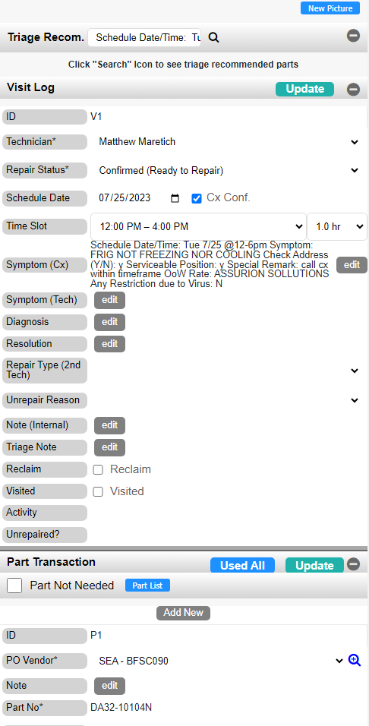
ER Mobile: How to Update tickets as a Technician
FYI: This refers to which number Visit you went out to service this Customer. If you are visiting the Customer for the first time, it will display as ‘V1.’ If you are visiting the Customer for the second time, it will display as ‘V2.’

Slide 6
ER Mobile: How to Update tickets as a Technician
1. To Complete or Pending your ticket, you can change the Repair Status here.

Slide 7
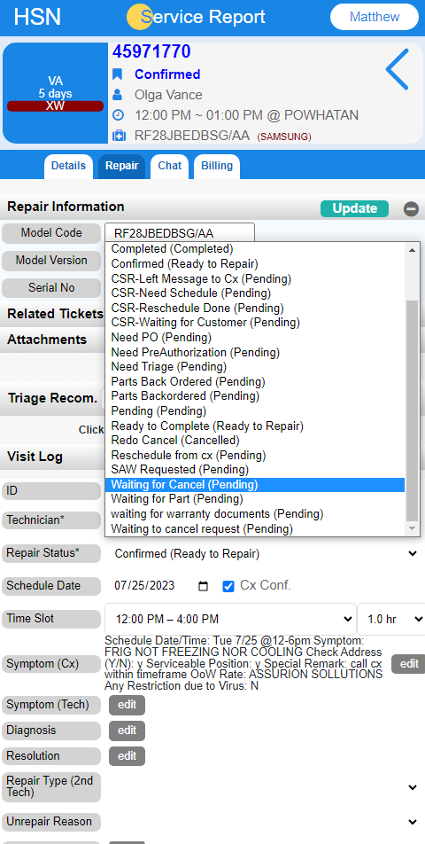
ER Mobile: How to Update tickets as a Technician
1. If you click on Repair Status, you can also select a variety of Completed or Pending reasons.

Slide 8
ER Mobile: How to Update tickets as a Technician
You can add notes by clicking on the Edit button located next to whichever note type you’re trying to add.
For example, if you’re trying to add notes about the Symptoms of the unit, you can click on the ‘Edit’ button next to ‘Symptom (Tech)’
3. If you’re done visiting the Customer, check mark the ‘Visited’ check box

Slide 9
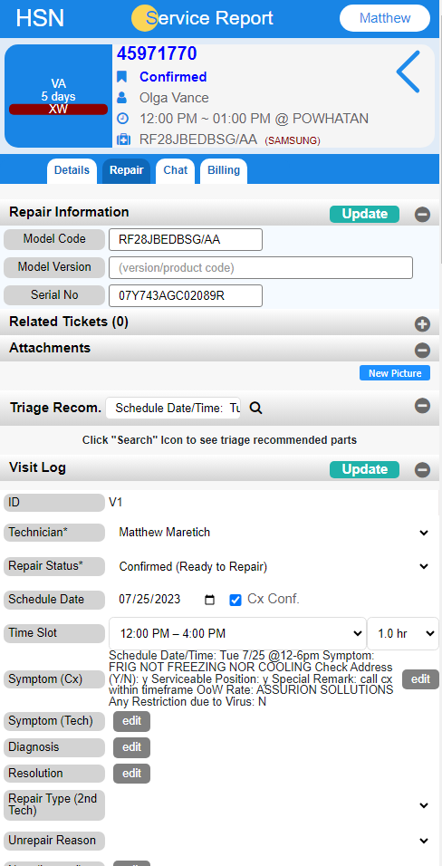
ER Mobile: How to Update tickets as a Technician
1. To attach pictures to the ticket, click on ‘New Picture’ under the Attachments tab

Slide 10
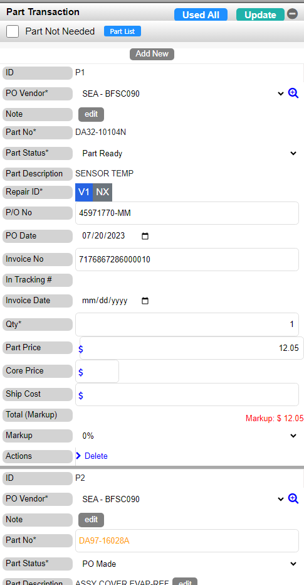
ER Mobile: How to Update tickets as a Technician
Scroll down to Part Transaction to see the list of parts reserved for this Ticket.
2. To add notes about a part, click on ‘Edit’ located next to ‘Note.’

Slide 11
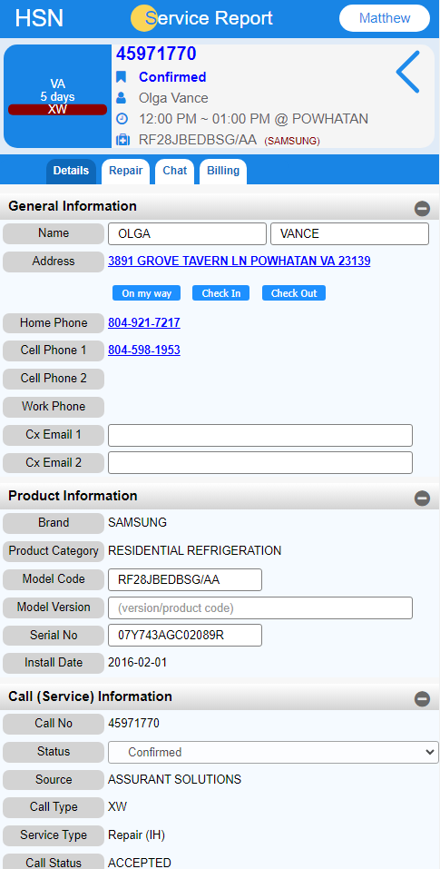
ER Mobile: How to Update tickets as a Technician
If you want leave regular comments for everyone to see, navigate to Details tab.

Slide 12
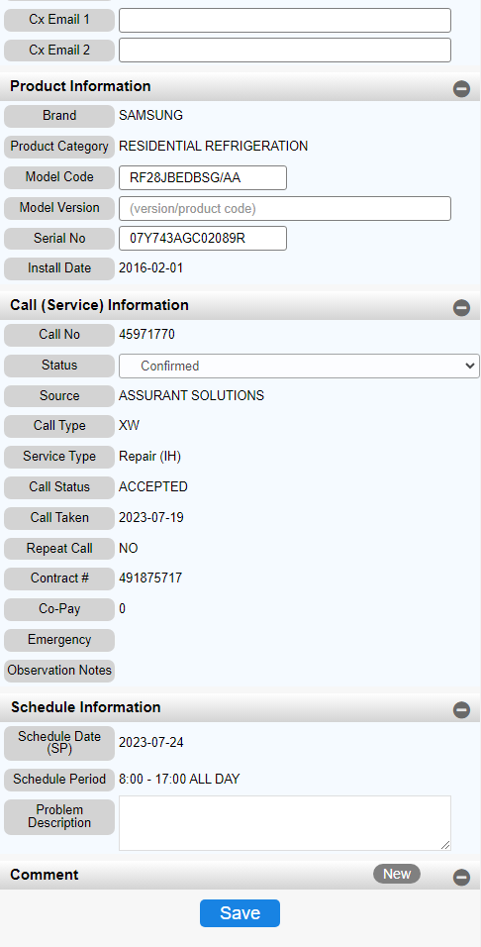
ER Mobile: How to Update tickets as a Technician
Scroll down to Comment and click on New to add a new comment.
Then click on Save to Update the ticket with the new comment you made.

